Slide 1
Completing Business messages
Noreen Shah​

Slide 2
Learning objectives
Discuss the value of careful revision, and describe the tasks involved in evaluating your first drafts and the work of other writers.
List four techniques you can use to improve the readability of your messages.
Describe eight steps you can take to improve the clarity of your writing, and give four tips on making your writing more concise.
List four principles of effective design, and explain the role of major design elements in document readability.
Explain the importance of proofreading and give eight tips for successful proofreading.
Discuss the most important issues to consider when distributing your messages.

Slide 3
EvALUATIng yoUR ConTEnT, oRgAnIzATIon, STyLE, AnD TonE
When you begin the revision process, focus your attention on content, organization, style, and tone. To evaluate the content of your message, answer these questions:
●● Is the information accurate?
●● Is the information relevant to the audience?
●● Is there enough information to satisfy the readers’ needs?

Slide 4
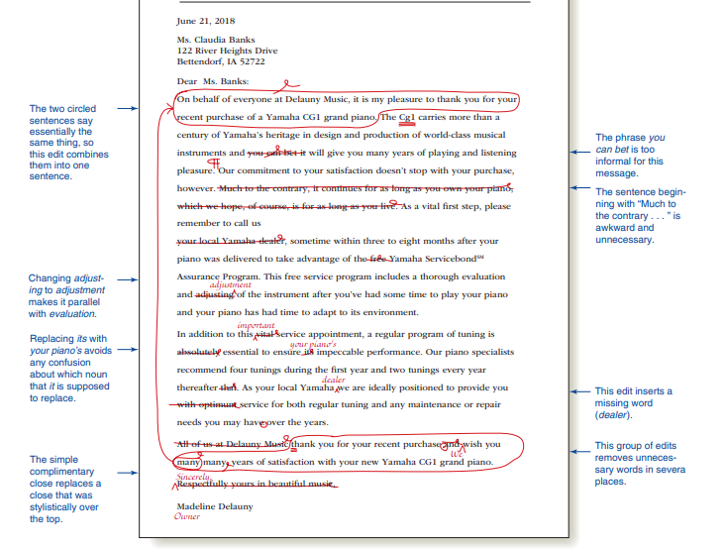

Slide 5
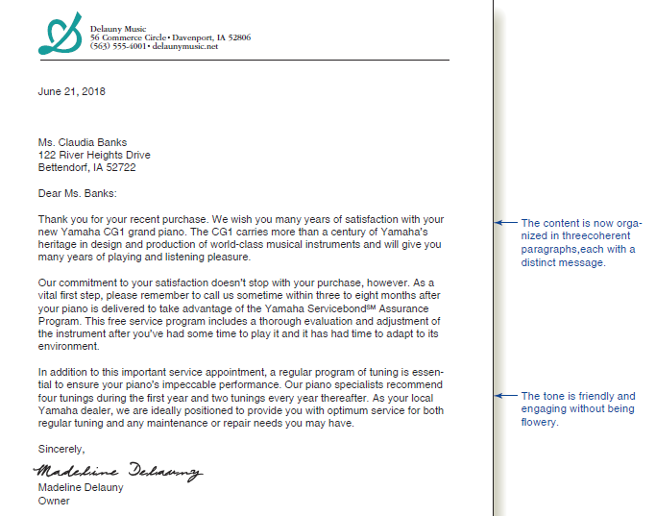

Slide 6
●● Is there a good balance between general information (giving readers enough background information to appreciate the message) and specific information (giving readers the details they need to understand the message)?
When you are satisfied with the content of your message, you can review its organization. Answer another set of questions:
●● Are all the points covered in the most logical order?
●● Do the most important ideas receive the most space, and are they placed in the most prominent positions?
●● Would the message be more convincing if it were arranged in a different sequence?
●● Are any points repeated unnecessarily?
●● Are details grouped together logically, or are some still scattered through the document?
Next, consider whether you have achieved the right tone for your audience. Is your writing formal enough to meet the audience’s expectations without being too formal or academic? Is it too casual for a serious subject?

Slide 7
EvALUATIng, EDITIng, AnD REvISIng ThE woRk oF oThERS
When you evaluate, edit, or revise someone else’s work, remember that your job is to help that person succeed, not to impose your own style. With those thoughts in mind, answer the following questions as you evaluate someone else’s writing:
●● What is the purpose of this document or message?
●● Who is the target audience?
●● What information does the audience need?
●● Does the document provide this information in a well-organized way?
●● Does the writing demonstrate the “you” attitude toward the audience?
●● Is the tone of the writing appropriate for the audience?
●● Can the readability be improved?
●● Is the writing clear? If not, how can it be improved?
●● Is the writing as concise as it could be?
●● Does the design support the intended message?

Slide 8
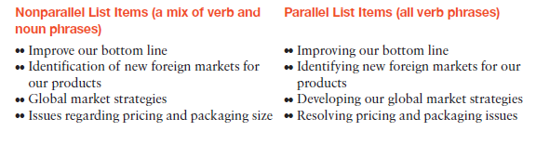
revising to improve readability
VARYING YOUR SENTENCE LENGTH
KEEPING YOUR PARAGRAPHS SHORT
USING LISTS TO CLARIFY AND EMPHASIZE

Slide 9
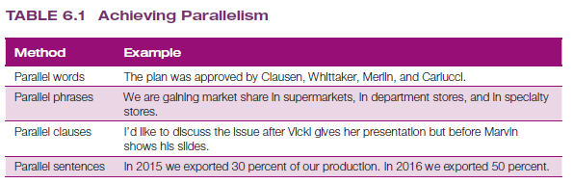

Slide 10
ADDIng hEADIngS AnD SUBhEADIngS
A heading is a brief title that tells readers about the content of the section that follows. Subheadings are subordinate to headings, indicating subsections within a major section. Headings and subheadings serve these important functions:
●● Organization. Headings show your reader at a glance how the document is organized. They act as labels to group related paragraphs and organize lengthy material into shorter sections.
●● Attention. Informative, inviting, and in some cases intriguing headings grab the reader’s attention, make the text easier to read, and help the reader find the parts he or she needs to read—or skip.
●● Connection. Using headings and subheadings together helps readers see the relationship between main ideas and subordinate ones so that they can understand your message more easily. Moreover, headings and subheadings visually indicate shifts from one idea to the next.
Descriptive headings, such as “Cost Considerations,” identify a topic but do little more. Informative headings, such as “Redesigning Material Flow to Cut Production Costs,” guide readers to think in a certain way about the topic.

Slide 11
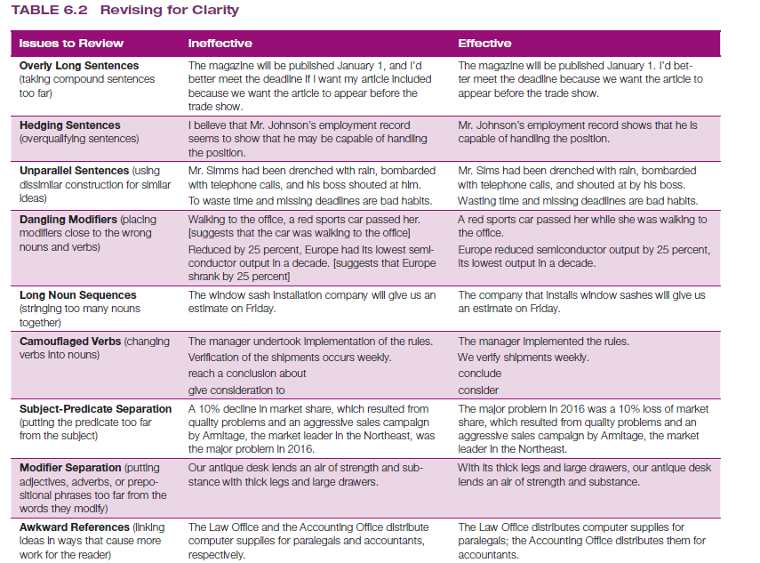
Editing for Clarity and Conciseness

Slide 12
EDITIng FoR ConCISEnESS
Delete unnecessary words and phrases.
Shorten long words and phrases.
Eliminate redundancies.
Rewrite “It is/There are” starters.

Slide 13
Producing Your Message

Slide 14
DESIgnIng FoR READABILITy
For effective design, pay attention to:
Consistency
Balance
Restraint
Detail
White Space
Margins and Justification
Typefaces
Type Styles

Slide 15
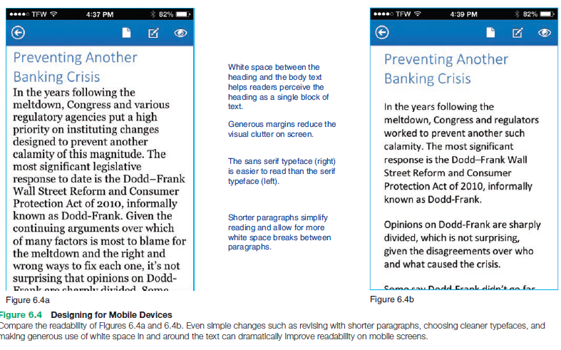
DESIgnIng MESSAgES FoR MoBILE DEvICES

Slide 16



CHECKLIST ✓ Proofing Business messages
C. Look for design, formatting, and programming mistakes.
A. Look for writing errors.
B. Look for missing elements.
●● Typographical mistakes
●● Misspelled words
●● Grammatical errors
●● Punctuation mistakes
●● Missing text sections
●● Missing exhibits (drawings, tables, photographs, charts, graphs, online images, and so on)
●● Missing source notes, copyright notices, or other reference items
●● Incorrect or inconsistent font selections
●● Problems with column sizing, spacing, and alignment
●● Incorrect margins
●● Incorrect special characters
●● Clumsy line and page breaks
●● Problems with page numbers
●● Problems with page headers and footers
●● Lack of adherence to company standards
●● Inactive or incorrect links
●● Missing files

Slide 17
Distributing Your Message
Cost
Convenience
Time
Security and privacy
Distribution method
Printing, binding, and delivering reports can be expensive,
so weigh the cost versus the benefits.
How much work is involved for you and your audience?
How soon does the message need to reach the audience?
The convenience offered by digital communication needs to be
weighed against security and privacy concerns
What is the best method of distributing your message?

Slide 18
Revising for Readability (Sentence Length)Break the following sentences into shorter ones by adding more periods, and revise as needed for smooth flow:
a. The next time you write something, check your average sentence length in a 100-word passage, and if your sentences average more than 16 to 20 words, see whether you can break up some of the sentences.
b. Don’t do what the village blacksmith did when he instructed his apprentice as follows: “When I take the shoe out of the fire, I’ll lay it on the anvil, and when I nod my head, you hit it with the hammer.” The apprentice did just as he was told, and now he’s the village blacksmith.
c. Unfortunately, no gadget will produce excellent writing, but using a yardstick like the Fog Index gives us some guideposts to follow for making writing easier to read because its two factors remind us to use short sentences and simple words.
d. Know the flexibility of the written word and its power to convey an idea, and know how to make your words behave so that your readers will understand.
e. Words mean different things to different people, and a word such as block may mean city block, butcher block, engine block, auction block, or several other things.

Slide 19
THANK YOU
Noreen Shah
noreen.shah@nu.edu.pk

